Slide 1
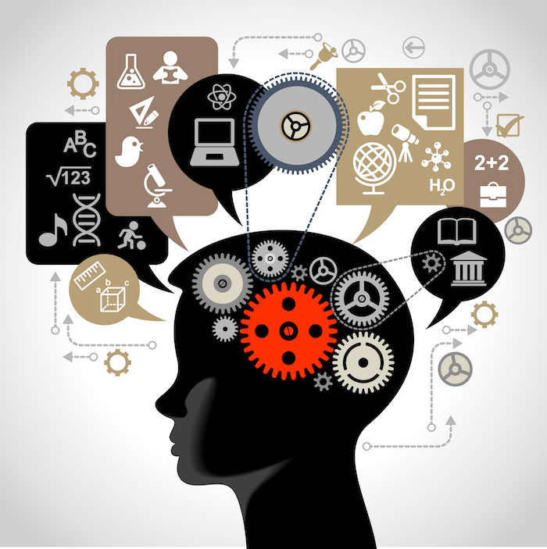
Technologies
Benefits and impacts in industries.
Chandrakant sm Hubli KTC
Technologies
Benefits and impacts on industries
Chandrakantsm
Hubli KTC

Slide 2

1.GPT:A tool that lets users enter prompts to receive images, text or videos that are created by AI.
1.GPT
Top 3 benefits:
1.Well researched output.
2.Well presented output.
3.Much faster response.
Impacts on industries:
Film industry: It can replace script writers, lots of creativity.
Journalism: Can replace article writers.
Law: It can fight the cases.
Education: can be effective in as well as affect the education sector.

Slide 3
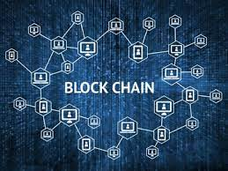
2.Blockchain:A system in which a record of transactions, especially those made in a cryptocurrency, is maintained across computers that are linked in a peer-to-peer network.
1.GPT
Top 3 benefits:
1.security of records.
2.transference of records .
3.Cost treduction.
Impacts on industries:
Law enforcement :Blockchain to ensure that video recordings used for evidence are genuine.
Cryptocurrency:its challenging the central banks .
Stock Markets:Blockchain based startups are automating and securing the process of shares buying and selling

Slide 4
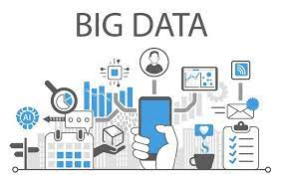

3.BIGDATA:Data that contains greater variety, arriving in increasing volumes and with more velocity, whose manipulation and management is a logistical challenge.
1.GPT
Top 3 benefits:
1.Improves business intelligency.
2.Risk management.
3.Cost reduction.
Impacts on industries:
Retail: helping retailers to design and market products with 100% accuracy at less cost.
Banking and Finance: Fraud detection.
Sports : Helping in hiring players , strategizing the game, pulling the crowd and ticket sales.

Slide 5
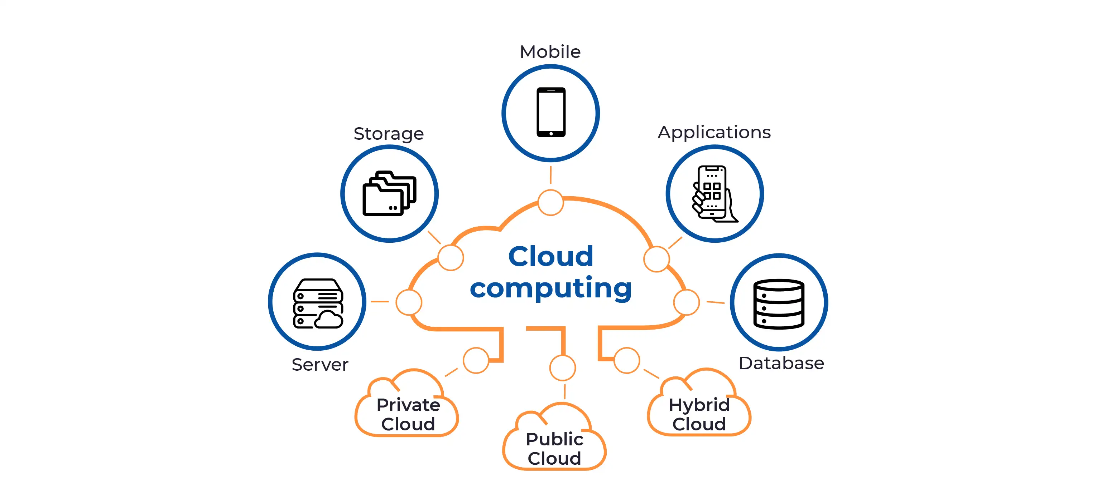
4.Cloud computing:Delivery of computing services—including servers, storage, databases, networking, software, analytics, and intelligence—over the Internet.
1.GPT
Top 3 benefits:
1. No investment in costly hardware or software.
2. Accessible from anywhere , anytime, any device .
3. Scale up or scale down of services requirement.
Impacts on industries:
Banking: Regional banks can compete with national and MNC banks
Healthcare: Small hospitals can provide any specialty treatment to any decease.
Data & cyber security: it cn negatively affect.
Ex: Mcaffee, Accenture.

Slide 6

5.Deep fake:Digital manipulation of videos, images, audios Utilizing powerful computers and deep learning to impersonate something else
1.GPT
Top 3 benefits:
1.To create high-quality entertainment content..
2. Getting Education from Its Masters.
3.Voice also can be manipulated using deep fake.
Impacts on industries:
Film industry: recreate scenes from classic movies or TV shows with modern actors, or to produce new movies .
Journalism: to authenticate the originality of every video they source
Law: Highly alert not to misjudge based on deep fake videos.

Slide 7
Technologies
Benefits and impacts in industries.
Chandrakant sm Hubli KTC
Thank you

